Slide 1
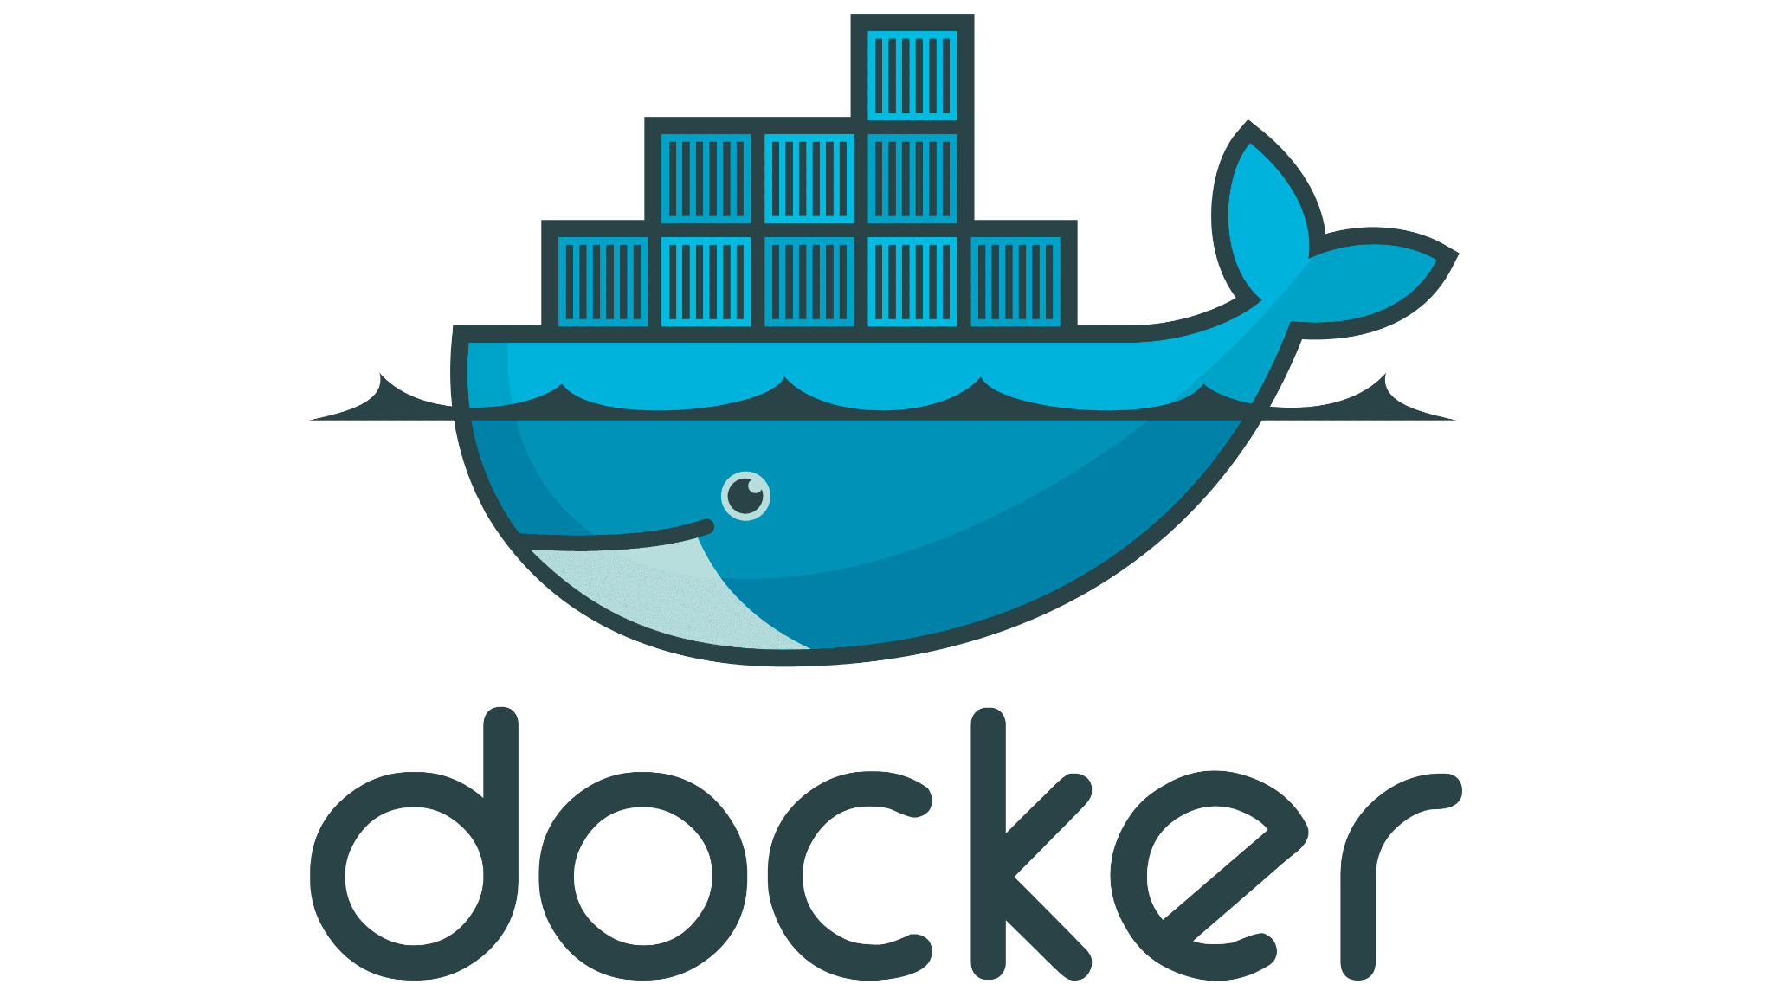


Contain(er) your problems using Docker
Swetank Poddar
swetankpoddar.me
linkedin.com/in/swetankpoddar
Notes:
Name’s Swetank
Currently a part of the graduate program at Barclays

Slide 2

The problem
Node.js developer
Java developer
Python developer
PHP developer
Notes:
Share your node.js application with a friend
Everyone’s computer has a different environment
Every application requires a custom environment

Slide 3
Solution
Isolated, system agnostic environments which configures itself.
Express JS
(Node.js)
Flask
(Python)
Spring boot
(Java)
Your machine
Notes:
Isolated: the environment should be isolated from the host machine’s env and other envs
System agnostic: the environment should be independent of the config in host machine
Configures itself: env should download and set up itself

Slide 4
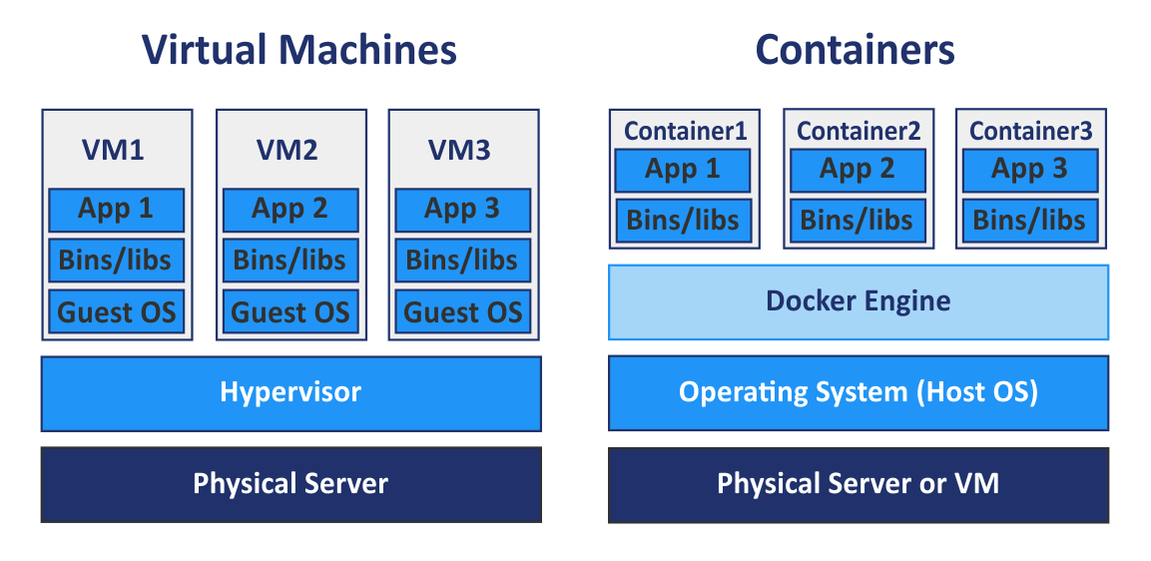
What’s wrong with VMs?
Notes:
Cons of VMs
VMs are very heavy (gigabytes)
Very long load up times
---
Guest OS is eliminated, the kernel is shared
---
Pros
Docker occupies less space
Docker boots up quicker
Better performance as all the apps are hosted under one docker engine
Easier to scale
Docker is more portable
https://www.baeldung.com/linux/docker-containers-evolution

Slide 5
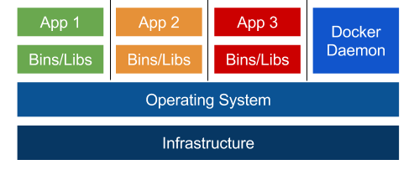
A more correct version of the image?
Notes:
The Docker Engine/Daemon is out of the execution path
It creates the containers and walls around it
The Docker Daemon is just another process
https://blog.mikesir87.io/2017/05/docker-is-not-a-hypervisor/

Slide 6
Welcome to the world of Docker!
Docker is a tool which allows us to automate the deployment of applications in lightweight containers so that the applications can work efficiently in different environments.
Notes:
Multiple containers can run on the same hardware
Docker ensures that the applications are isolate
Highly productive
Quick and easy to configure

Slide 7
Docker engine
Docker Client
(CLI or Docker Desktop)
Docker Daemon
REST API
Notes:
Docker client: Docker Desktop or CLI
Docker Daemon: Does all the magic
Custom clients can be created using the REST APIs.

Slide 8
Docker’s lifecycle
Dockerfile
Image
Container
Image repository
Notes:
Docker’s lifecycle is made up of 4 key components
Dockerfile -> Image -> Container
Image can be downloaded/uploaded from image repository

Slide 9
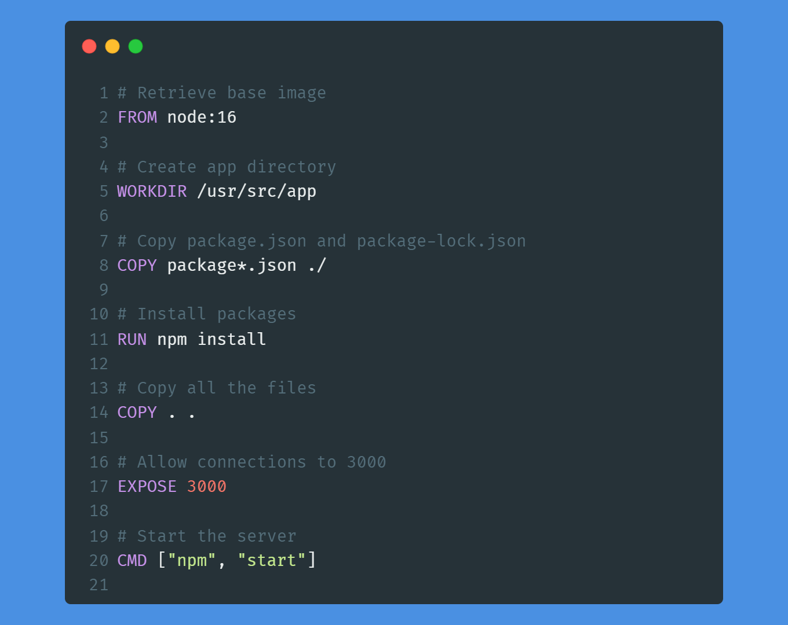
DockerFile Example
Notes:
SLOW DOWN!!!!!
A Dockerfile is a text document that contains all the commands that are needed to assemble an image.
FROM - base image
WORKDIR - set the directory where the commands should be executed (cd - change directory command)
COPY - Copy with regex match
RUN - Run shell commands
COPY - Copy everything from current directory (i.e. where the docker file is present) of the host machine to current directory in the container
EXPOSE - Open the port to allow others to connect with the container
CMD - Entrypoint (should finish everything before this)
Carbon.now.sh
https://nodejs.org/en/docs/guides/nodejs-docker-webapp/

Slide 10
Docker Image
A Docker image is a redistributable and a compiled form of a Dockerfile.
docker build . -t node-web-app
Notes:
Dockerfile is a class -> Docker image is an object
CMD explanation
Docker build -> the command
“.” -> look for Dockerfile in the current directory
“-t” -> tag the image build using this Dockerfile as “node-web-app”.

Slide 11
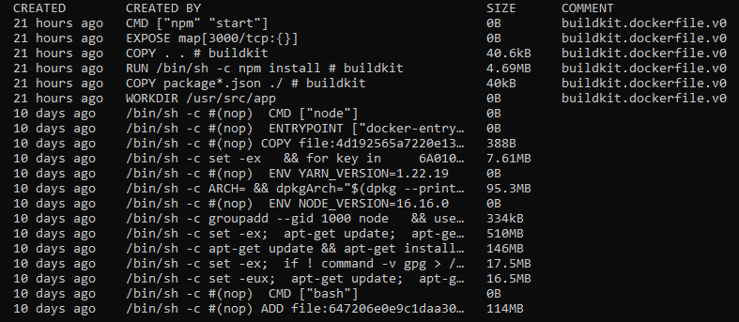
Your
image
Base
image
docker image history node-web-app
“Layers” in a docker image
Notes:
Every line of instruction in the docker image results in new image.
Cashing mechanism saves time (eg installing node)

Slide 12
Docker container
Docker container is an “instance” of a Docker image.
docker run -p 3000:3000 -d node-web-app
Notes:
A Docker container is a standalone executable software package which includes applications and their dependencies.
“Docker run” - command
“-p” - port mapping host machine to an exposed port in the container
“-d” - run in detached form
“Node-web-app” name of the image

Slide 13
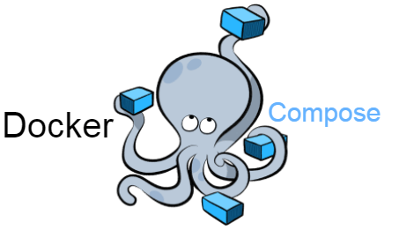
Docker compose
Docker compose is a tool for defining and running multi container docker applications.
Notes:
Very hectic to manage multiple containers by yourself
Easier to create networks, volumes etc.

Slide 14
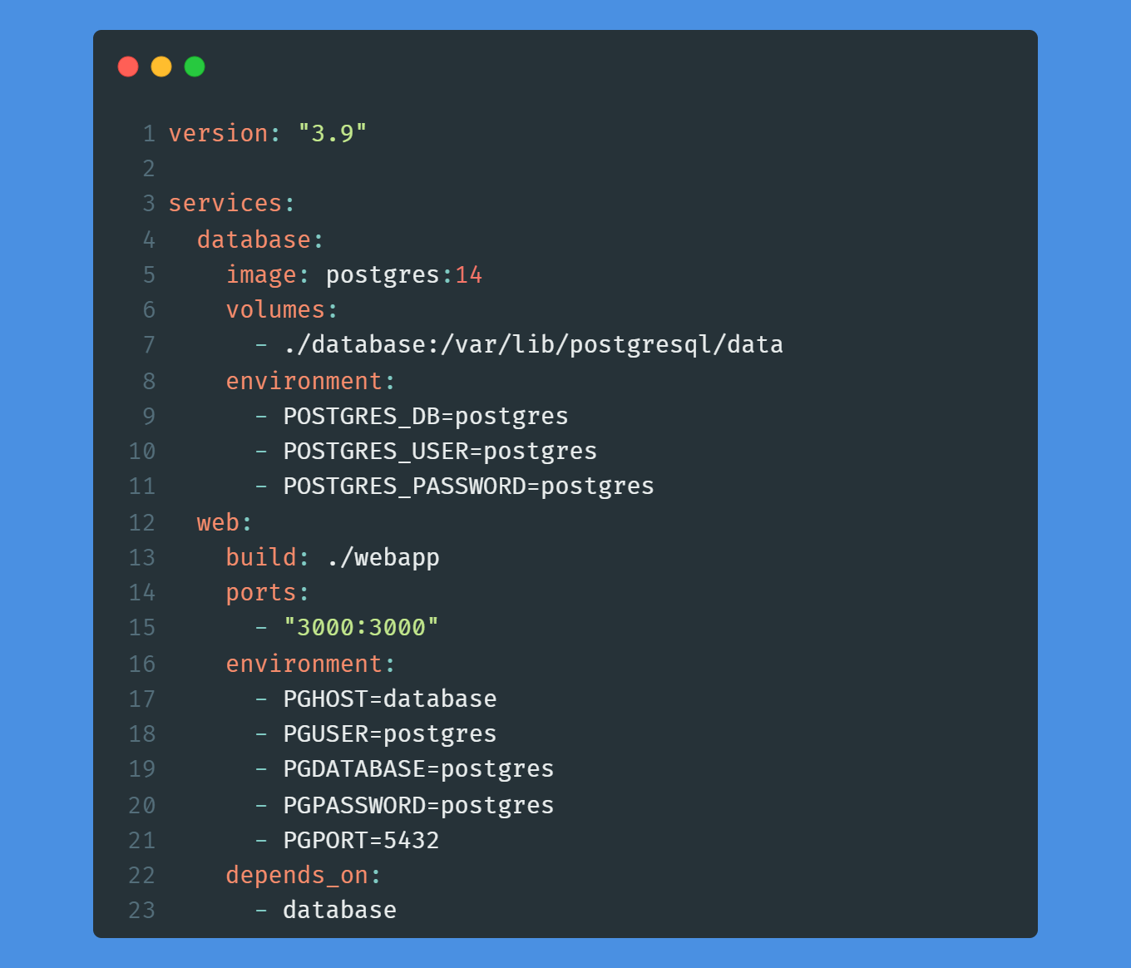
Example of docker-compose.yml
Notes:
SLOW DOWN!!!!
Version - Docker compose version
services - the containers we want to run
Volumes - maps a path on container to your host machine
Depends on - ensures that the web service is build only if the database is up

Slide 15
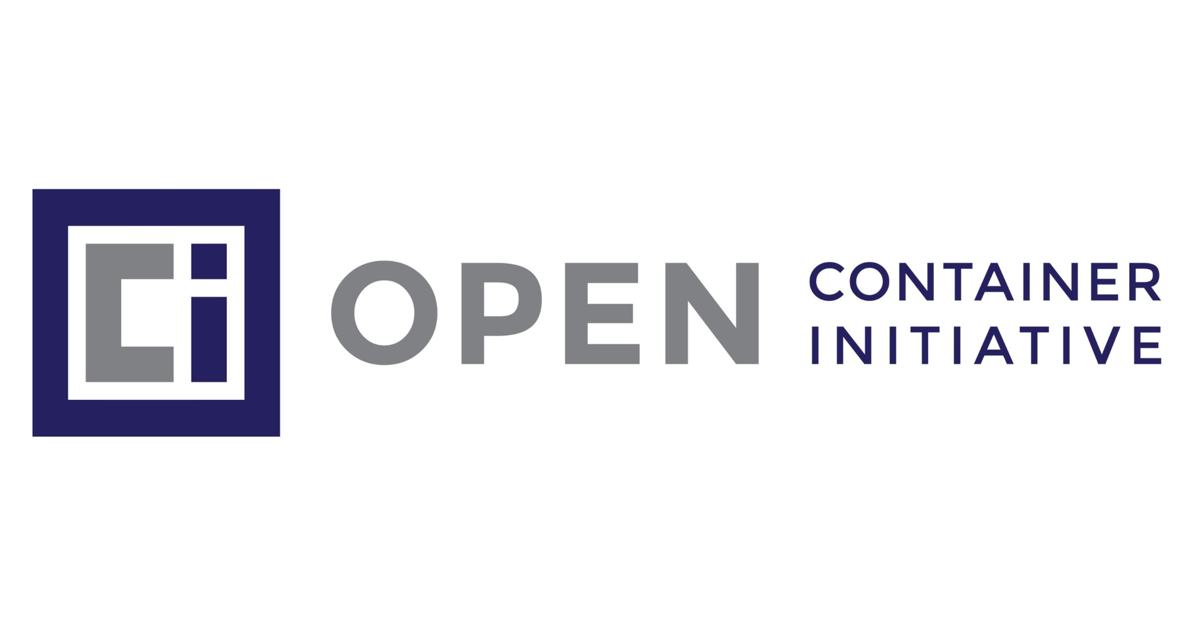
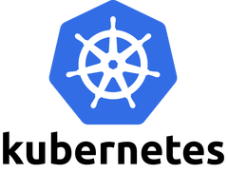
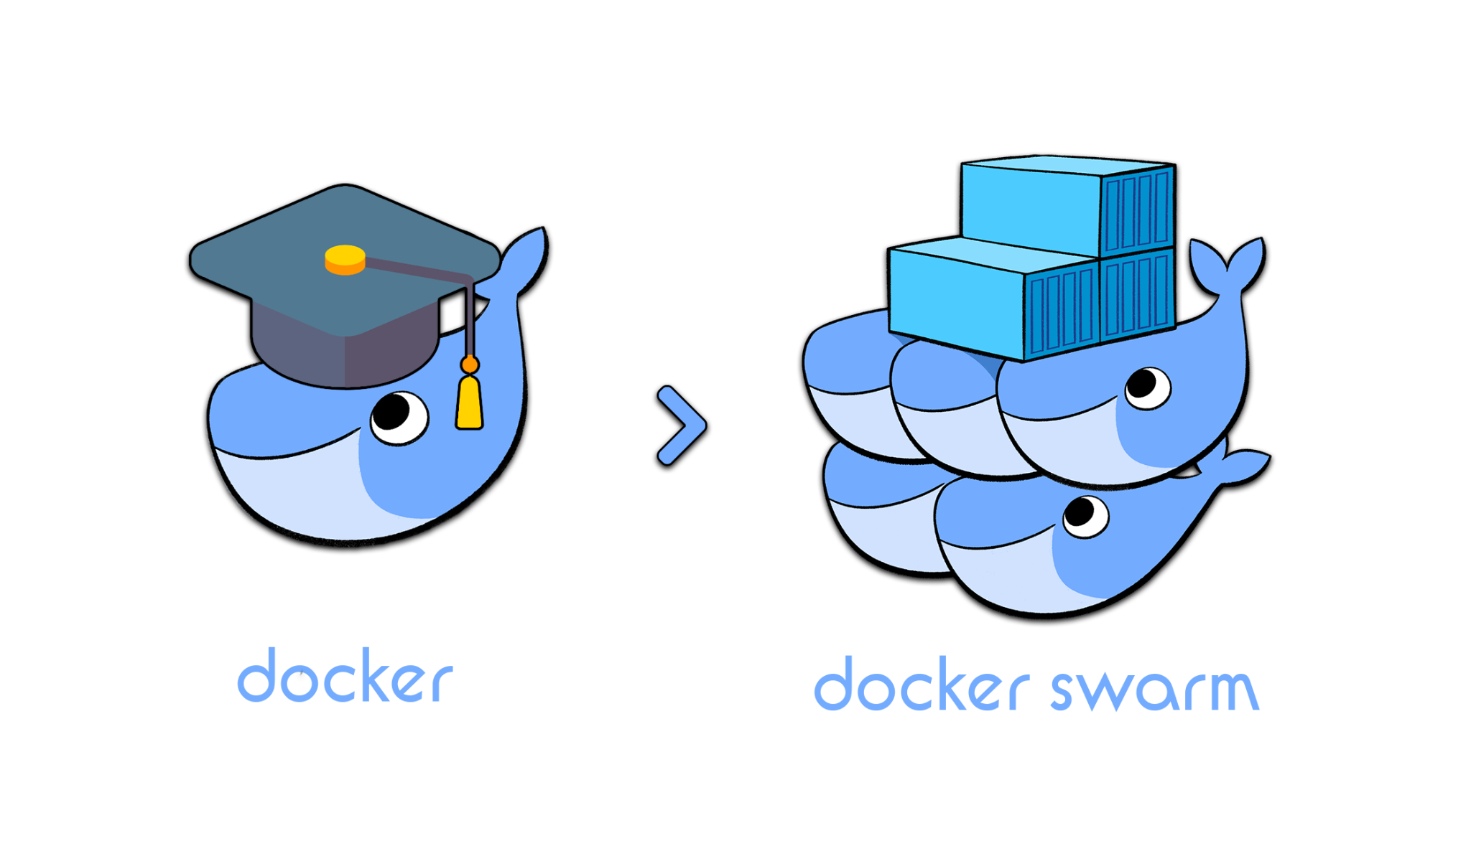
Future of Docker
Notes:
Docker released in 2013
OCI - standardizing protocols around containers
Container availability
Scaling or removing containers based on balancing workloads across your infrastructure
Load balancing and traffic routing
Monitoring container health

Slide 16
Key takeaways
Docker’s focus is on creating portable and replicable environments.
Docker can be used in nearly every stage (except the early stages) of a software development life cycle.
Docker is an ideal solution for environment related problems for local development.

Slide 17

Thanks for listening!
Any questions?
Presentation resources
@
SwetankPoddar/docker-presentation
swetankpoddar.me
linkedin.com/in/swetankpoddar
Notes:
Keith Harrison and Joe Wright

